Slide 1
Chapter 6 Methods

Slide 2
Opening Problem
Find the sum of integers from 1 to 10, from 20 to 30, and from 35 to 45, respectively.

Slide 3
Problem
int sum = 0;
for (int i = 1; i <= 10; i++)
sum += i;
System.out.println("Sum from 1 to 10 is " + sum);
sum = 0;
for (int i = 20; i <= 30; i++)
sum += i;
System.out.println("Sum from 20 to 30 is " + sum);
sum = 0;
for (int i = 35; i <= 45; i++)
sum += i;
System.out.println("Sum from 35 to 45 is " + sum);

Slide 4
Problem
int sum = 0;
for (int i = 1; i <= 10; i++)
sum += i;
System.out.println("Sum from 1 to 10 is " + sum);
sum = 0;
for (int i = 20; i <= 30; i++)
sum += i;
System.out.println("Sum from 20 to 30 is " + sum);
sum = 0;
for (int i = 35; i <= 45; i++)
sum += i;
System.out.println("Sum from 35 to 45 is " + sum);

Slide 5
Solution
public static int sum(int i1, int i2) {
int sum = 0;
for (int i = i1; i <= i2; i++)
sum += i;
return sum;
}
public static void main(String[] args) {
System.out.println("Sum from 1 to 10 is " + sum(1, 10));
System.out.println("Sum from 20 to 30 is " + sum(20, 30));
System.out.println("Sum from 35 to 45 is " + sum(35, 45));
}

Slide 6
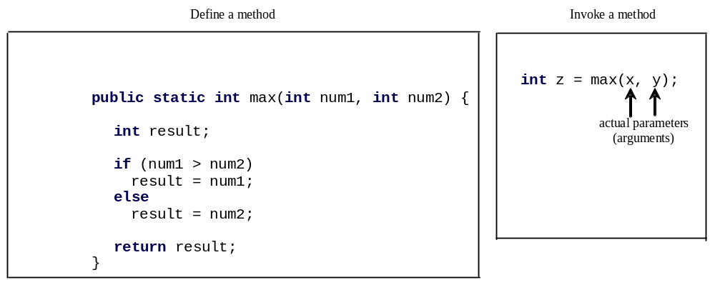
Defining Methods
A method is a collection of statements that are grouped together to perform an operation.

Slide 7
TestMax.java
Pages 208 Listing 6.1

Slide 8

Defining Methods
A method is a collection of statements that are grouped together to perform an operation.

Slide 9
Method Signature
Method signature is the combination of the method name and the parameter list.

Slide 10
Formal Parameters
The variables defined in the method header are known as formal parameters.

Slide 11
Actual Parameters
When a method is invoked, you pass a value to the parameter. This value is referred to as actual parameter or argument.

Slide 12
Return Value Type
A method may return a value. The returnValueType is the data type of the value the method returns. If the method does not return a value, the returnValueType is the keyword void. For example, the returnValueType in the main method is void.

Slide 13
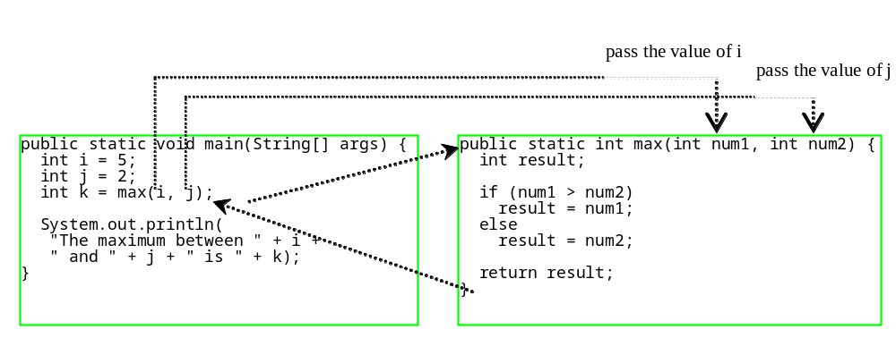
Calling Methods, cont.
animation

Slide 14

CAUTION
A return statement is required for a value-returning method. The method shown below in (a) is logically correct, but it has a compilation error because the Java compiler thinks it possible that this method does not return any value.
To fix this problem, delete if (n < 0) in (a), so that the compiler will see a return statement to be reached regardless of how the if statement is evaluated.

Slide 15
Reuse Methods from Other Classes
NOTE: One of the benefits of methods is for reuse. The max method can be invoked from any class besides TestMax. If you create a new class Test, you can invoke the max method using ClassName.methodName (e.g., TestMax.max).

Slide 16
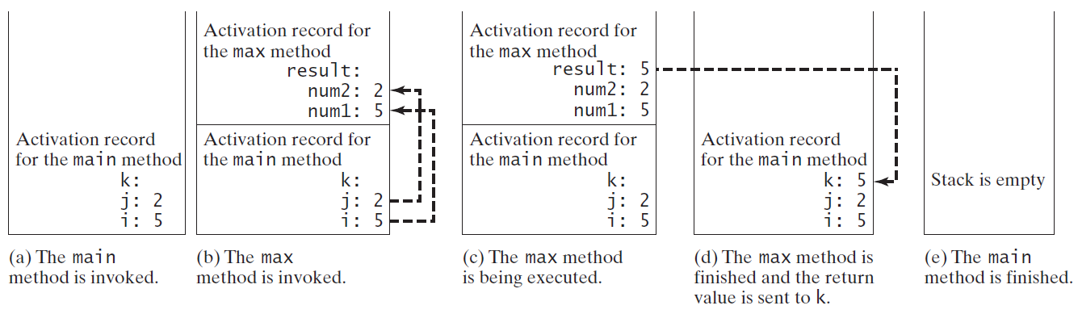
Call Stacks

Slide 17
TestVoidMethod.java
Page 211 Listing 6.2

Slide 18
TestReturnGradeMethod.java
Page 212 Listing 6.3

